Slide 1
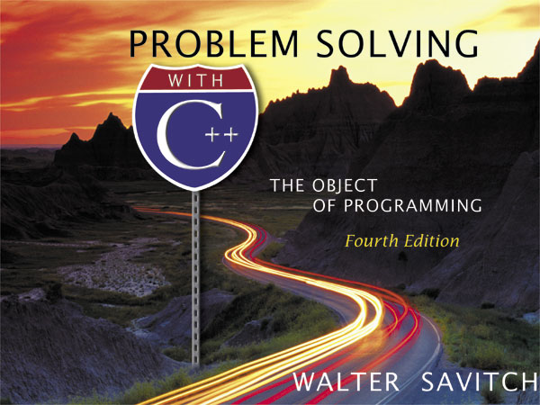
Copyright © 2003 Pearson Education, Inc.
Slide <number>

Slide 2
Chapter 17
Exception Handling
Created by David Mann, North Idaho College
Copyright © 2003 Pearson Education, Inc.
Slide <number>

Slide 3
Overview
Exception Handling Basics (17.1)
Programming Techniques for _x000b_Exception Handling (17.2)_x000b_
Copyright © 2003 Pearson Education, Inc.
Slide <number>

Slide 4
Exception Handling Basics
17.1
It is often easier to write a program by first
assuming that nothing incorrect will happen
Once it works correctly for the expected
cases, add code to handle the exceptional cases
Exception handling is commonly used to handle
error situations
  Once an error is handled, it is no longer an error
Copyright © 2003 Pearson Education, Inc.
Slide <number>

Slide 5
Functions and
Exception Handling
A common use of exception handling:
  Functions with a special case that is handled in
  different ways depending on how the function is
  used
  If the function is used in different programs, each
  program may require a different action when the
  special case occurs
Copyright © 2003 Pearson Education, Inc.
Slide <number>

Slide 6
Exception Handling Mechanism
In C++, exception handling proceeds by:
  Some library software or your code signals that
  something unusual has happened
  This is called throwing an exception
  At some other place in your program you place the
  code that deals with the exceptional case
  This is called handling the exception
Copyright © 2003 Pearson Education, Inc.
Slide <number>

Slide 7
A Toy Example
Exception handling is meant to be used sparingly
in situations that are generally not reasonable
introductory examples
For this example:
  Suppose milk is so important that we almost never
  run out
  We still would like our program to handle the
  situation of running out of milk
Copyright © 2003 Pearson Education, Inc.
Slide <number>

Slide 8
The Milk Example (cont.)
Code to handle the normal situations involving
milk, might be:
cout << "Enter number of donuts:\n";
cin >> donuts;
cout << "Enter number of glasses of milk:\n";
cin >> milk;
dpg = donuts /static_cast<double>(milk);
cout << donuts << " donuts.\n"
<< milk << " glasses of milk.\n"
<< "You have " << dpg
<< " donuts per glass of milk.\n";
Copyright © 2003 Pearson Education, Inc.
Slide <number>

Slide 9
The No Milk Problem
If there is no milk, the code on the previous slide
results in a division by zero
  We could add a test case for this situation
  shows the program with the test
  case
  shows the program rewritten
  using an exception
Display 17.1
Display 17.2 (1-2)
Copyright © 2003 Pearson Education, Inc.
Slide <number>

Slide 10
The try Block
The program of Display 17.2 replaces the test
case in the if-else statement with
if(milk <= 0)
throw donuts;
This code is found in the try block
try
{
Some_Code
}
which encloses the code to handle the normal situations
Copyright © 2003 Pearson Education, Inc.
Slide <number>

Slide 11
The Try Block Outline
The try block encloses code that you want to
"try" but that could cause a problem
The basic outline of a try block is:
try
{
Code_To_Try
Possibly_Throw_An_Exception
More_Code
}
Copyright © 2003 Pearson Education, Inc.
Slide <number>

Slide 12
The Exception
To throw an exception, a throw-statement is
used to throw a value
  In the milk example:
  throw donuts;
  throws an integer value.
  The value thrown is sometimes called an exception
  You can throw a value of any type
Copyright © 2003 Pearson Education, Inc.
Slide <number>

Slide 13
The catch-block
Something that is thrown goes from one place
to another
In C++ throw causes the flow of control to go
to another place
  When an exception is thrown, the try block stops
  executing and the catch-block begins execution
  This is catching or handling the exception
Copyright © 2003 Pearson Education, Inc.
Slide <number>

Slide 14
The Milk catch-block
The catch-block from the milk example looks
like, but is not, a function definition with a
parameter:
catch(int e)
{
cout << e << donuts, and no milk!\n"
<< "Go buy some milk.\n";
}
  If no exception is thrown, the catch-block is ignored
  during program execution
Copyright © 2003 Pearson Education, Inc.
Slide <number>

Slide 15
The catch-block Parameter
The catch-block parameter, (recall that the
catch-block is not a function) does two things:
  The type of the catch-block parameter identifies the
  kind of value the catch-block can catch
  The catch-block parameter provides a name for the
  value caught so you can write code using the value
  that is caught
Copyright © 2003 Pearson Education, Inc.
Slide <number>

Slide 16
try-blocks and if-else
try-blocks are very similar to if-else statements
  If everything is normal, the entire try-block is
  executed
  else, if an exception is thrown, the catch-block is
  executed
A big difference between try-blocks and if-else
statements is the try-block's ability to send a
message to one of its branches
Copyright © 2003 Pearson Education, Inc.
Slide <number>

Slide 17
try-throw-catch Review
This is the basic mechanism for throwing and
catching exceptions
  The try-block includes a throw-statement
  If an exception is thrown, the try-block ends and the
  catch-block is executed
  If no exception is thrown, then after the try-block
  is completed, execution continues with the code
  following the catch-block(s)
Copyright © 2003 Pearson Education, Inc.
Slide <number>

Slide 18
Defining an Exception Class
Because a throw-statement can throw a value of
any type, it is common to define a class whose
objects can carry the kind of information you
want thrown to the catch-block
A more important reason for a specialized
exception class is so you can have a different
type to identify each possible kind of exceptional
situation
Copyright © 2003 Pearson Education, Inc.
Slide <number>

Slide 19
The Exception Class
An exception class is just a class that happens to
be used as an exception class
An example of a program with a programmer
defined exception class is in
Display 17.3 (1-2)
Copyright © 2003 Pearson Education, Inc.
Slide <number>

Slide 20
Throwing a Class Type
The program in Display 17.3 uses the
throw-statement
throw NoMilk(donuts);
  This invokes a constructor for the class NoMilk
  The constructor takes a single argument of type int
  The NoMilk object is what is thrown
  The catch-block then uses the statement
  e.get_donuts( )
  to retrieve the number of donuts
Copyright © 2003 Pearson Education, Inc.
Slide <number>

Slide 21
Multiple Throws and Catches
A try-block can throw any number of exceptions
of different types
  In any one execution, only one exception can be
  thrown
  Each catch-block can catch only one exception
  Multiple catch-blocks may be used
    A parameter is not required in a catch-block
A sample program with two catch-blocks is
found in
Display 17.4 (1-3)
Copyright © 2003 Pearson Education, Inc.
Slide <number>

Slide 22
A Default catch-block
When catching multiple exceptions, write the
catch-blocks for the most specific exceptions
first
  Catch-blocks are tried in order and the first one
  matching the type of exception is executed
A default (and last) catch-block to catch any
exception can be made using "…" as the
catch-block parameter
catch(…)
{ <the catch block code> }
Copyright © 2003 Pearson Education, Inc.
Slide <number>

Slide 23
Exception Class DivideByZero
In Display 17.4, exception class DivideByZero
was defined as
class DivideByZero
{ } ;
  This class has no member variables or member functions
  This is a trivial exception class
  DivideByZero is used simply to activate the appropriate
  catch-block
  There is nothing to do with the catch-block parameter so
  it can be omitted as shown in Display 17.4
Copyright © 2003 Pearson Education, Inc.
Slide <number>

Slide 24
Exceptions In Functions
In some cases, an exception generated in a
function is not handled in the function
  It might be that some programs should end, while
  others might do something else, so within the function
  you might not know how to handle the exception
In this case, the program places the function
invocation in a try block and catches the
exception in a following catch-block
Copyright © 2003 Pearson Education, Inc.
Slide <number>

Slide 25
Function safe_divide
The program of Display 17.5 includes a
function that throws, but does not catch an
exception
  In function safe_divide, the denominator is checked
  to be sure it is not zero. If it is zero, an exception
  is thrown:
  if (bottom == 0)
  throw DivideByZero( );
  The call to function safe_divide is found in the try-block of
  the program
Copyright © 2003 Pearson Education, Inc.
Slide <number>

Slide 26
Exception Specification
If a function does not catch an exception it should
warn programmers than an exception might be
thrown by the function
  An exception specification, also called a throw list,
  appears in the function declaration and definition:
  double safe_divide(int n, int d) throw (DivideByZero);
  if multiple exceptions are thrown and not caught by a function:
  double safe_divide(int n, int d)
  throw (DivideByZero, OtherException);
Display 17.5 (1-2)
Copyright © 2003 Pearson Education, Inc.
Slide <number>

Slide 27
Exceptions Not Listed
If an exception is not listed in an exception
specification and not caught by the function:
  The program ends
If there is no exception specification at all, it is
the same as if all possible exceptions are listed
  These exceptions will be treated "normally"
An empty exception specification list means that
no exceptions should be thrown and not caught
Copyright © 2003 Pearson Education, Inc.
Slide <number>

Slide 28
Sample
Exception Specifications
void some_function ( ) throw ( );
//empty exception list; so all exceptions not
// caught by the function end the program
void some_function( ) throw(DivideByZero,
OtherException);
//Exceptions DivideByZero and OtherException
//treated normally. All others end the program
void some_function( );
// All exceptions of all types treated normally
// If not caught by a catch-block, the program ends
Copyright © 2003 Pearson Education, Inc.
Slide <number>

Slide 29
Derived Classes and Exceptions
Remember that an object of a derived class is
also an object of the base class
  If D is a derived class of B and B is in an exception
  specification
    A thrown object of class D will be treated normally since
    it is an object of class B
Copyright © 2003 Pearson Education, Inc.
Slide <number>

Slide 30
Type Conversion
No automatic type conversions are done with
exceptions
  if double is in the exception specification, an int
  cannot be thrown unless int is also in the exception
  specification
Copyright © 2003 Pearson Education, Inc.
Slide <number>

Slide 31
Function Redefinitions in Derived Classes
Functions redefined or overloaded in derived
classes should have the same exception
specification as in the base class
  The exception specification can be a subset of the
  exception specification in the base class
    You cannot add exceptions
Copyright © 2003 Pearson Education, Inc.
Slide <number>

Slide 32
Section 17.1 Conclusion
Can you
  List the three components of exception handling?
  Write code to catch an exception of type char?
  Create an exception specification for a function?
  Create an exception class?
Copyright © 2003 Pearson Education, Inc.
Slide <number>

Slide 33
Programming Techniques for Exception Handling
17.2
A guideline for exception handling is to
separate throwing an exception and catching an
exception into separate functions
  Place the throw-statement in one function and list
  the exception in the exception specification
  Place the function invocation and catch-clause
  in a try-block of a different function
Copyright © 2003 Pearson Education, Inc.
Slide <number>

Slide 34
try and throw…Again
Here is a general example the approach to use
in using throw:
void functionA( ) throw (MyException)
{
…
throw MyException(<an argument?>);
}
Copyright © 2003 Pearson Education, Inc.
Slide <number>

Slide 35
catch…again
Using FunctionA from the previous slide, here
is how to catch MyException:
void functionB( )
{
…
try
{
…
functionA( );
…
}
catch(MyException e)
{
< handle the exception>
}
}
Copyright © 2003 Pearson Education, Inc.
Slide <number>

Slide 36
When to Throw An Exception
Throwing exceptions is generally reserved for
those cases when handling the exceptional case
depends on how and where the function was
invoked
  In these cases it is usually best to let the programmer
  calling the function handle the exception
  An uncaught exception ends your program
If you can easily write code to handle the problem
do not throw an exception
Copyright © 2003 Pearson Education, Inc.
Slide <number>

Slide 37
Nested try-catch Blocks
Although a try-block followed by its catch-block
can be nested inside another try-block
  It is almost always better to place the nested
  try-block and its catch-block inside a function
  definition, then invoke the function in the outer
  try-block
An error thrown but not caught in the inner
try-catch-blocks is thrown to the outer try-block
where it might be caught
Copyright © 2003 Pearson Education, Inc.
Slide <number>

Slide 38
Overuse of Exceptions
Throwing an exception allows you to transfer
flow of control to almost any place in your
program
Such un-restricted flow of control is generally
considered poor programming style as it makes
programs difficult to understand
Exceptions should be used sparingly and only
when you cannot come up with an alternative that
produces reasonable code
Copyright © 2003 Pearson Education, Inc.
Slide <number>

Slide 39
Exception Class Hierarchies
It can be useful to define a hierarchy of exception
classes.
  You might have an ArithmeticError exception class
  with DivideByZeroError as a derived class
  Since a DivideByZeroError object is also an
  ArithmeticError object, every catch-block for an
  ArithmeticError will also catch a DivideByZeroError
Copyright © 2003 Pearson Education, Inc.
Slide <number>

Slide 40
Checking For Available Memory
The new operator allocates memory from the
freestore: NodePtr pointer = new Node;
  What if there is no memory available?
  bad_alloc is a predefined exception and can be used
  in this way since new throws a bad_alloc exception:
  try
  {
  NodePtr pointer = new Node;
  }
  catch(bad_alloc)
  {
  cout << "Ran out of memory!";
  }
Copyright © 2003 Pearson Education, Inc.
Slide <number>

Slide 41
Rethrowing an Exception
The code within a catch-block can throw
an exception
  This feature can be used to pass the same or a
  different exception up the chain of exception
  handling blocks
Copyright © 2003 Pearson Education, Inc.
Slide <number>

Slide 42
Section 17.2 Conclusion
Can you
  Describe what happens if an exception is never
  caught?
  Write code that nests a try-block inside another
  try-block?
  Describe the type of situations in which exceptions
  should not be thrown?
Copyright © 2003 Pearson Education, Inc.
Slide <number>

Slide 43
Chapter 17 -- End
Copyright © 2003 Pearson Education, Inc.
Slide <number>

Slide 44
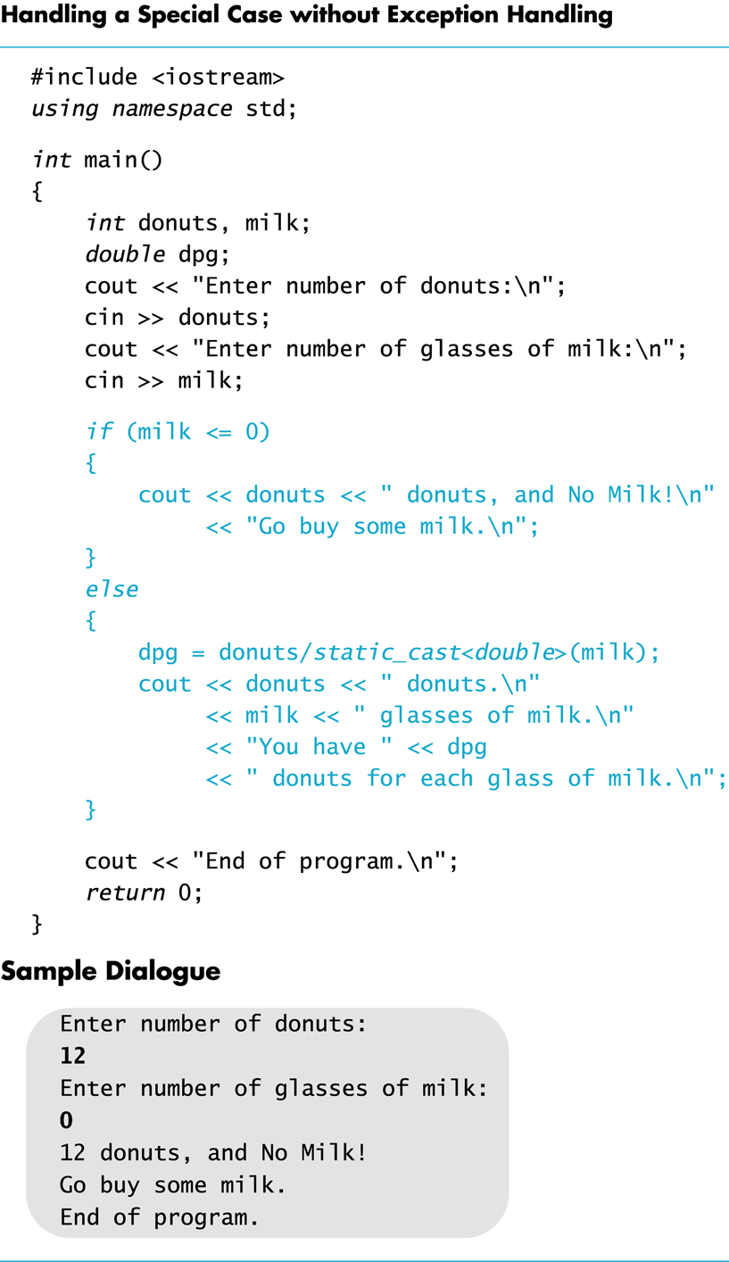
Display 17.1
Back
Next
Copyright © 2003 Pearson Education, Inc.
Slide <number>

Slide 45
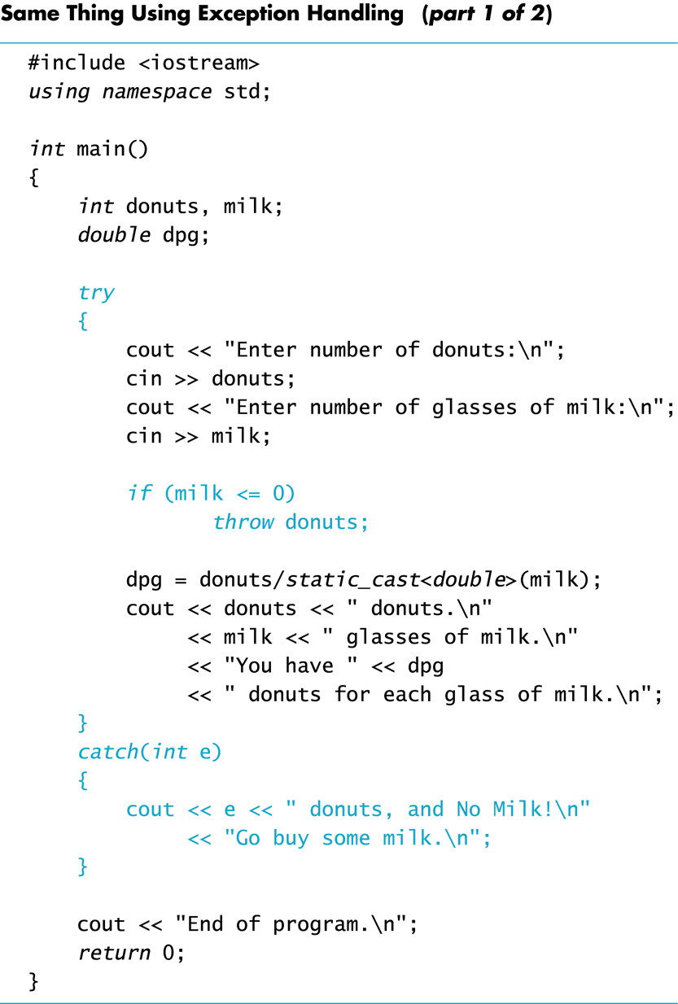
Display 17.2
(1/2)
Back
Next
Copyright © 2003 Pearson Education, Inc.
Slide <number>

Slide 46
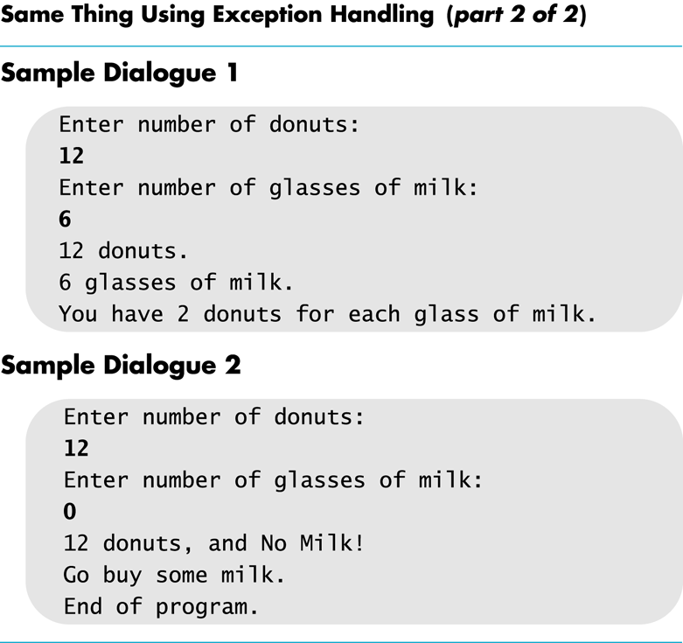
Display 17.2
(2/2)
Back
Next
Copyright © 2003 Pearson Education, Inc.
Slide <number>

Slide 47
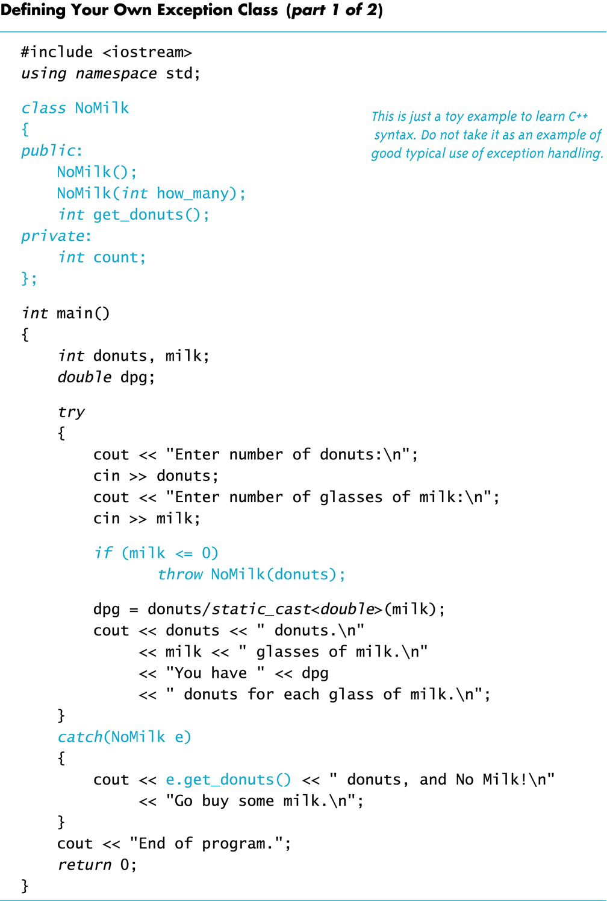
Display 17.3
(1/2)
Back
Next
Copyright © 2003 Pearson Education, Inc.
Slide <number>

Slide 48
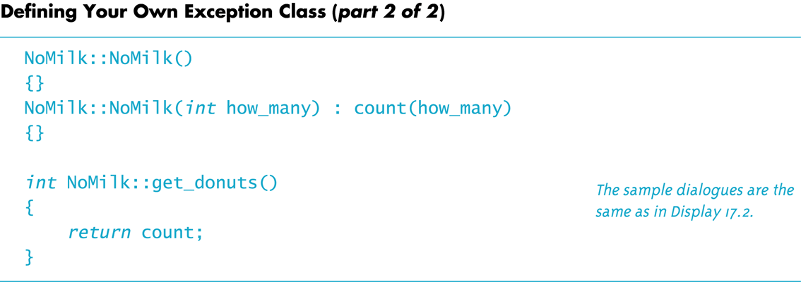
Display 17.3
(2/2)
Back
Next
Copyright © 2003 Pearson Education, Inc.
Slide <number>

Slide 49
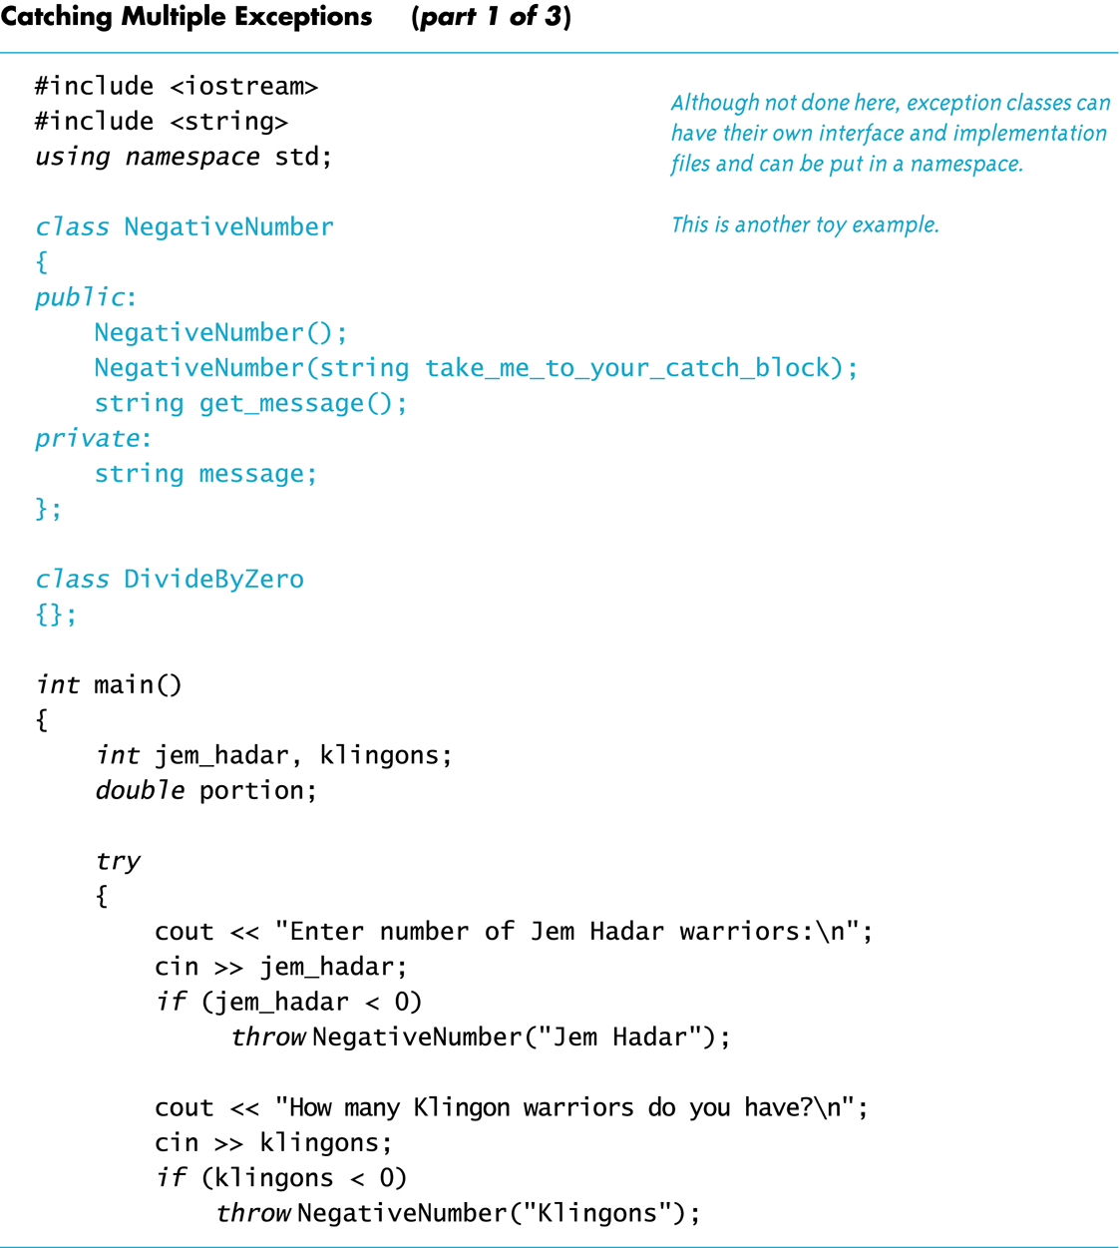
Display 17.4
(1/3)
Back
Next
Copyright © 2003 Pearson Education, Inc.
Slide <number>

Slide 50
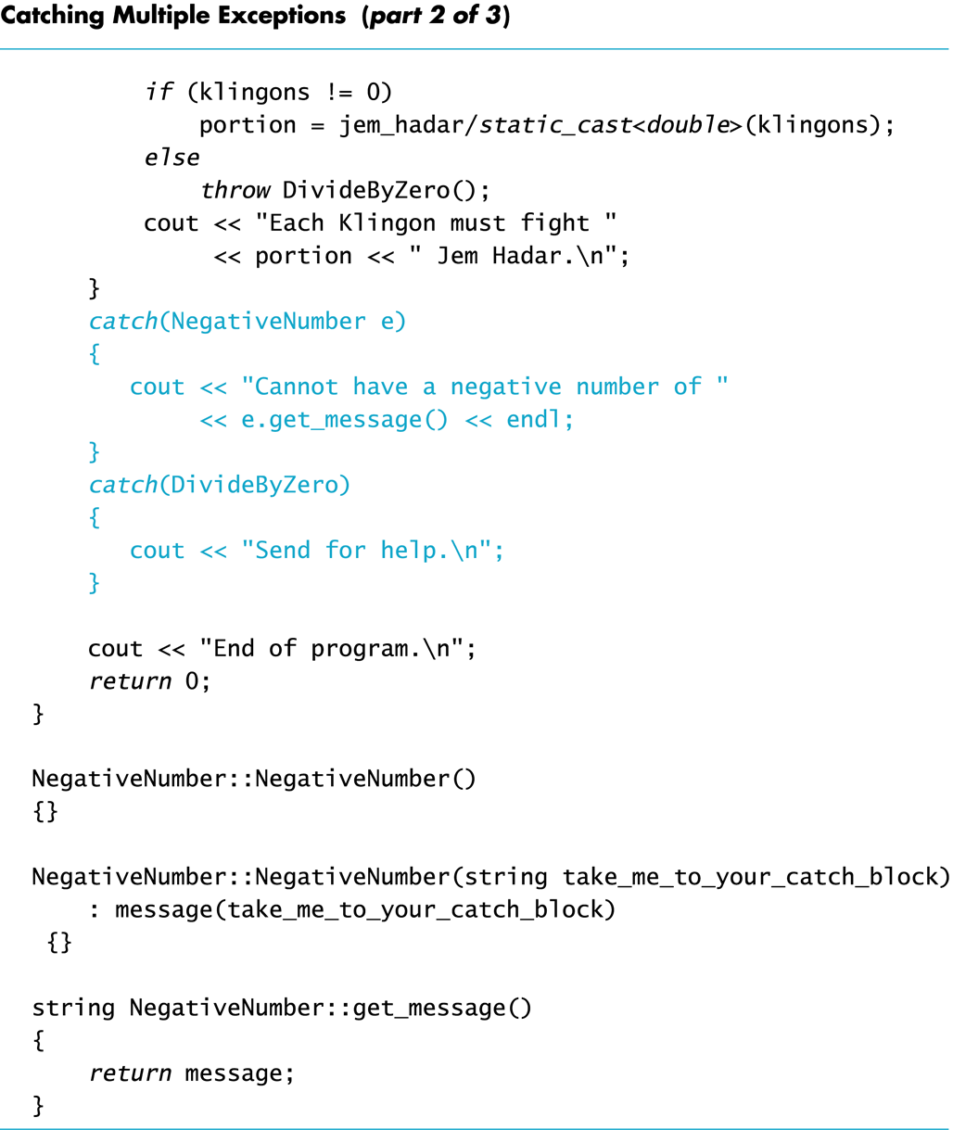
Display 17.4
(2/3)
Back
Next
Copyright © 2003 Pearson Education, Inc.
Slide <number>

Slide 51
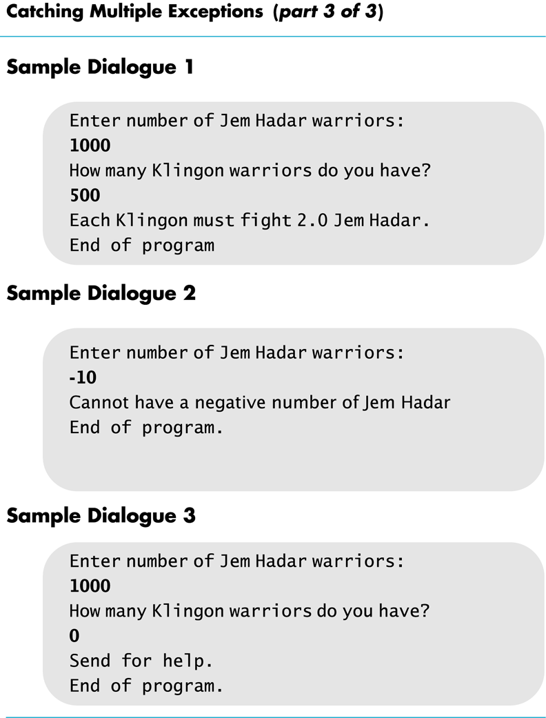
Display 17.4
(3/3)
Back
Next
Copyright © 2003 Pearson Education, Inc.
Slide <number>

Slide 52
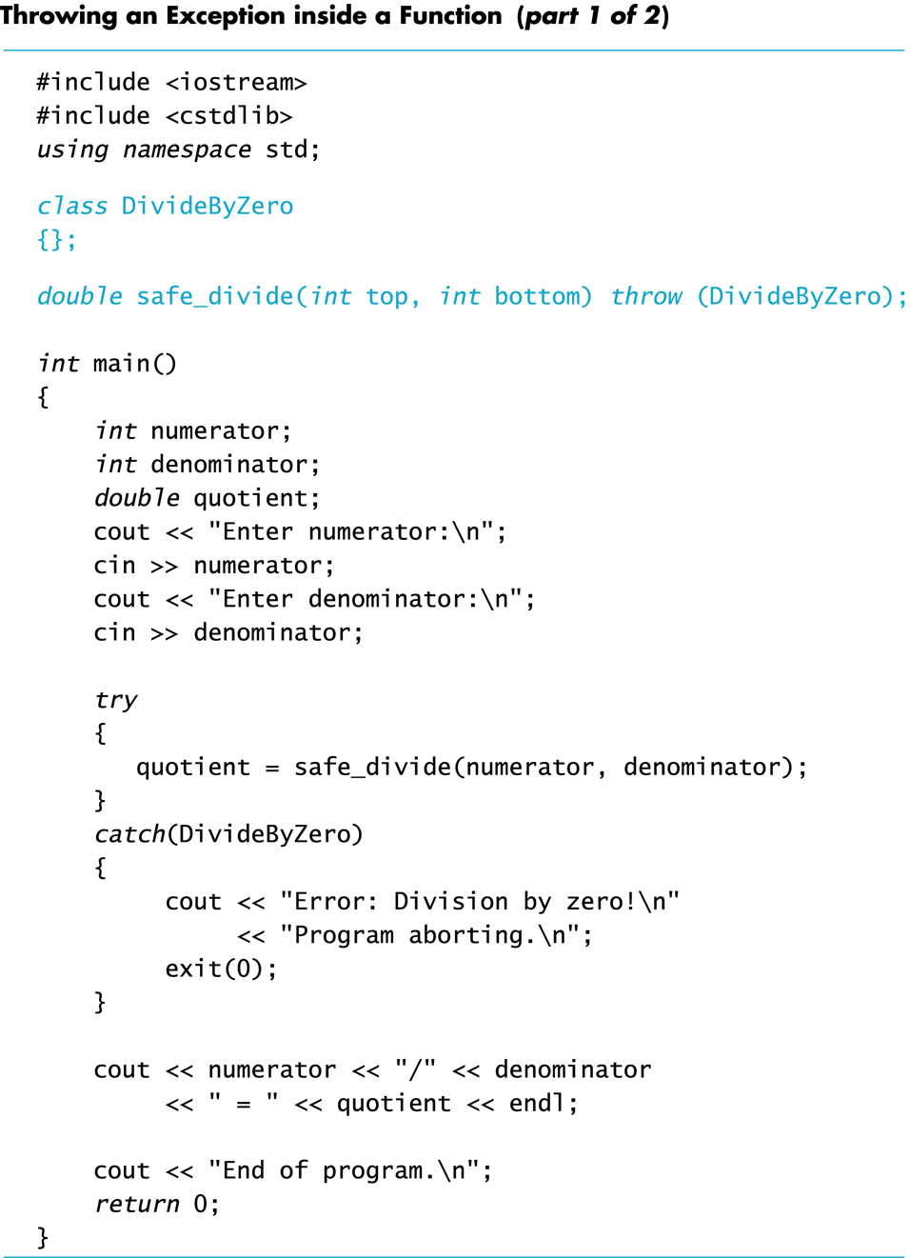
Display 17.5
(1/2)
Back
Next
Copyright © 2003 Pearson Education, Inc.
Slide <number>

Slide 53
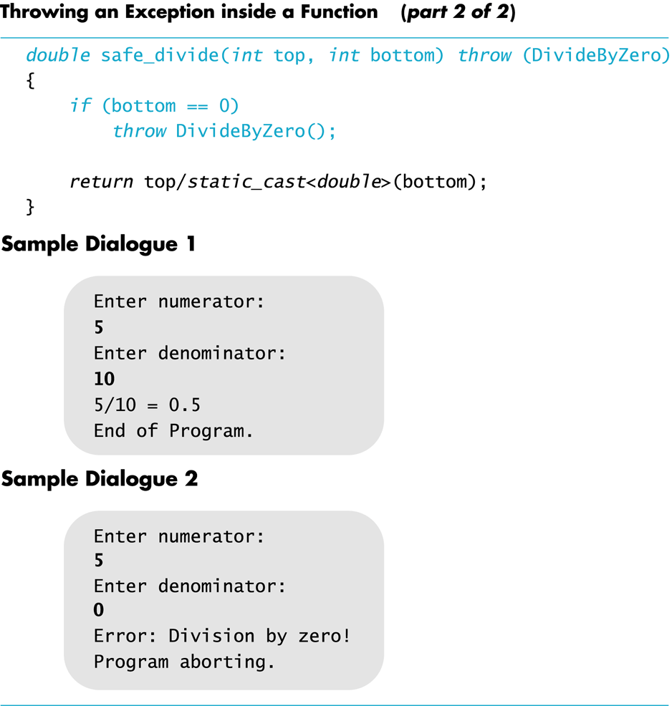
Display 17.5
(2/2)
Back
Next
Copyright © 2003 Pearson Education, Inc.
Slide <number>

